Slide 1
Day 11 Plant Fossils

Slide 2
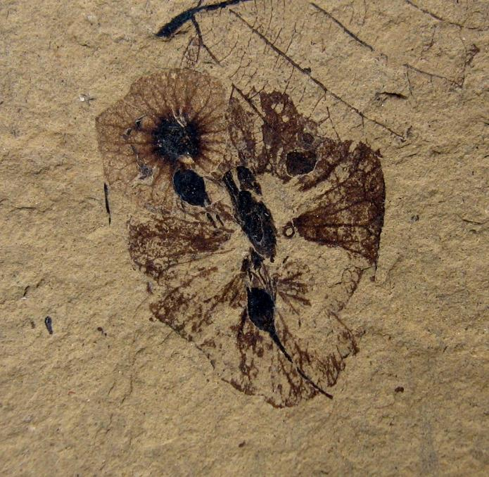
Fossil 1
URL: https://commons.wikimedia.org/wiki/File:Dillhoffia_cachensis_SR_92-17-20_1.jpg
Attribution: Kevmin, CC BY-SA 3.0 <https://creativecommons.org/licenses/by-sa/3.0>, via Wikimedia Commons

Slide 3
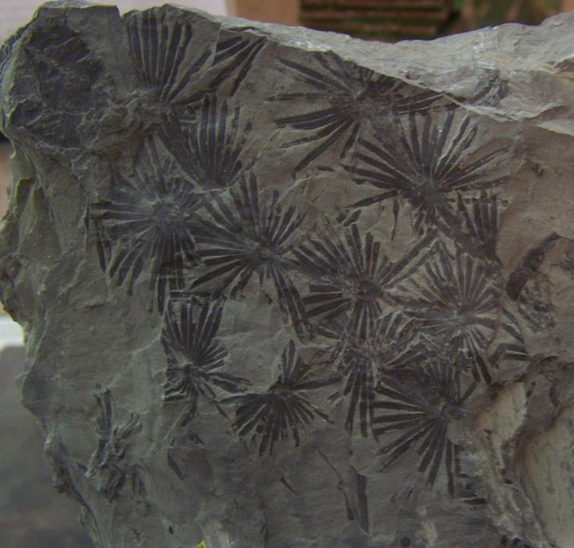
Fossil 5
URL: https://commons.wikimedia.org/wiki/File:Annularia_Stellata.jpg
Attribution: Woudloper, Public domain, via Wikimedia Commons

Slide 4
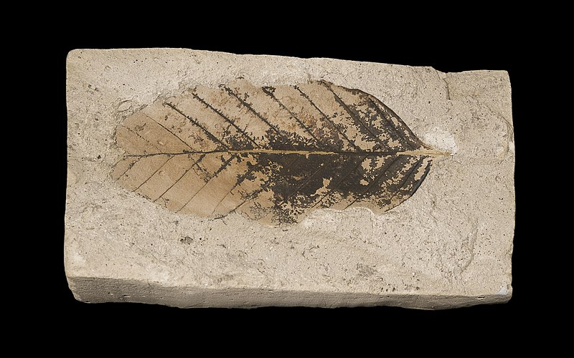
Fossil 7
URL: https://commons.wikimedia.org/wiki/File:Fagus_sylvatica_pliocenica_MHNT.PAL.VEG.2002.31.jpg
Attribution: Muséum de Toulouse, CC BY-SA 4.0 <https://creativecommons.org/licenses/by-sa/4.0>, via Wikimedia Commons

Slide 5
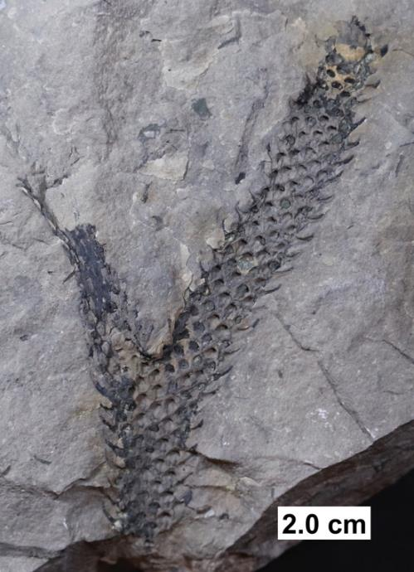
Fossil 26
URL: https://commons.wikimedia.org/wiki/File:Lycopod_axis.jpg
Attribution: Kennethgass, CC BY-SA 4.0 <https://creativecommons.org/licenses/by-sa/4.0>, via Wikimedia Common

Slide 6
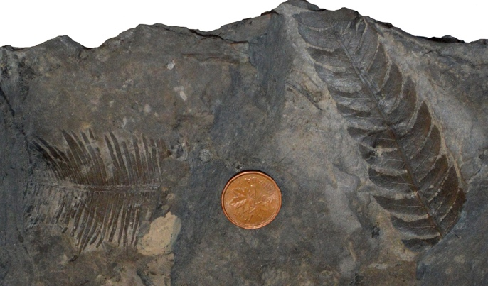
Fossil 12
URL: https://commons.wikimedia.org/wiki/File:Early_Cretaceous_Plant_Fossils.jpg
Attribution: Georgialh, CC BY-SA 3.0 <https://creativecommons.org/licenses/by-sa/3.0>, via Wikimedia Commons

Slide 7
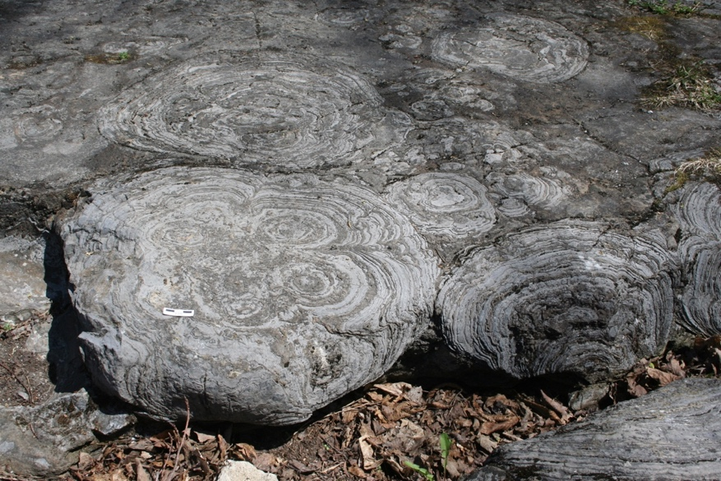
Fossil 17
URL: https://commons.wikimedia.org/wiki/File:Stromatolites_hoyt_mcr1.JPG
Attribution: https://upload.wikimedia.org/wikipedia/commons/d/d7/Stromatolites_hoyt_mcr1.JPG

Slide 8
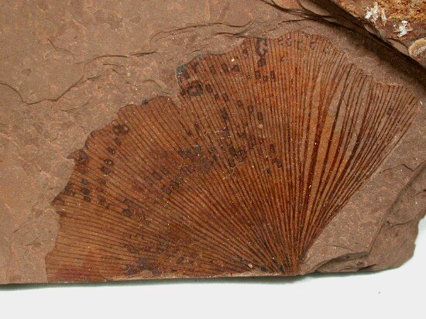
Fossil 20
URL: https://commons.wikimedia.org/wiki/File:Ginkgo_biloba_MacAbee_BC.jpg
Attribution: User:SNP(upload to en:wikipedia) ; User:tangopaso (transfer to Commons), CC BY-SA 3.0 <http://creativecommons.org/licenses/by-sa/3.0/>, via Wikimedia Commons

Slide 9
Figure Cite Key
Figure 1
URL: https://commons.wikimedia.org/wiki/File:Dillhoffia_cachensis_SR_92-17-20_1.jpg
Attribution: Kevmin, CC BY-SA 3.0 <https://creativecommons.org/licenses/by-sa/3.0>, via Wikimedia Commons
Figure 5
URL: https://commons.wikimedia.org/wiki/File:Annularia_Stellata.jpg
Attribution: Woudloper, Public domain, via Wikimedia Commons
Figure 7
URL: https://commons.wikimedia.org/wiki/File:Fagus_sylvatica_pliocenica_MHNT.PAL.VEG.2002.31.jpg
Attribution: Muséum de Toulouse, CC BY-SA 4.0 <https://creativecommons.org/licenses/by-sa/4.0>, via Wikimedia Commons
Figure 26
URL: https://commons.wikimedia.org/wiki/File:Lycopod_axis.jpg
Attribution: Kennethgass, CC BY-SA 4.0 <https://creativecommons.org/licenses/by-sa/4.0>, via Wikimedia Common
Figure 12
URL: https://commons.wikimedia.org/wiki/File:Early_Cretaceous_Plant_Fossils.jpg
Attribution: Georgialh, CC BY-SA 3.0 <https://creativecommons.org/licenses/by-sa/3.0>, via Wikimedia Commons
Figure 17
URL: https://commons.wikimedia.org/wiki/File:Stromatolites_hoyt_mcr1.JPG
Attribution: https://upload.wikimedia.org/wikipedia/commons/d/d7/Stromatolites_hoyt_mcr1.JPG
Figure 20
URL: https://commons.wikimedia.org/wiki/File:Ginkgo_biloba_MacAbee_BC.jpg
Attribution: User:SNP(upload to en:wikipedia) ; User:tangopaso (transfer to Commons), CC BY-SA 3.0 <http://creativecommons.org/licenses/by-sa/3.0/>, via Wikimedia Commons

