Slide 1
Day 6 Images

Slide 2
Liverwort
Common pellia (Pellia epiphylla) is a type of liverwort.
It can be found growing in patches on wet areas such as the banks of streams or river, wet woodland areas and even on rocks.
URL: https://commons.wikimedia.org/wiki/File:Pellia_epiphylla_200108.jpg
Attribution: Bernd Haynold, CC BY-SA 3.0 &lt;https://creativecommons.org/licenses/by-sa/3.0&gt;, via Wikimedia Commons

Slide 3
Lunularia cruciata is a type of leafy liverwort.
URL: https://commons.wikimedia.org/wiki/File:Lunularia_cruciata_(a,_144340-481024)_6579.JPG
Attribution: HermannSchachner, CC0, via Wikimedia Commons

Slide 4
Hornworts
Hornworts like this Ceratophylum demersum grow in damp places and can grow like tiny weeds in a garden.
Why do you suppose these are called hornworts ?
URL: https://commons.wikimedia.org/wiki/File:Ceratophyllum_demersum,_hornwort,_rigid_hornwo rt,_coontail,_or_coon%27s_tail._.jpg
Attribution:Renjusplace, CC BY-SA 3.0 &lt;https://creativecommons.org/licenses/by-sa/3.0&gt;, via Wikimedia Commons

Slide 5
Hornwart
This hornwort is growing on the side of a tree.
URL: https://commons.wikimedia.org/wiki/File:Dendroceros.jpg
Attribution: J.Ziffer, Public domain, via Wikimedia Commons

Slide 6
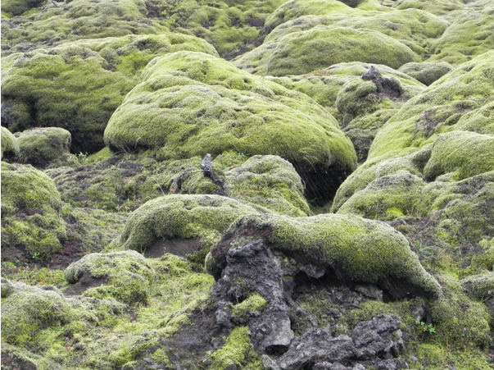
Moss:
Moss can cover the ground and rocks like a carpet!
URL: https://commons.wikimedia.org/wiki/File:Route_1_,_Between_Vik_and_Kirkjub%C3%A6jarklaustur_-_panoramio_(7).jpg
Attribution: Patrick Nouhailler's…, CC BY-SA 3.0 <https://creativecommons.org/licenses/by-sa/3.0>, via Wikimedia Commons

Slide 7
Moss
This moss is growing on a concrete wall.
URL: https://commons.wikimedia.org/wiki/File:MossOnConcreteWall.jpgceae
Attribution: Wvangeit, CC BY-SA 4.0 <https://creativecommons.org/licenses/by-sa/4.0>, via Wikimedia Commons

