Slide 1
Day 8 Images

Slide 2
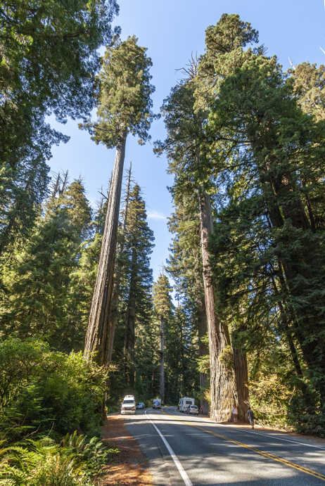
Sequoia Redwood
Sequoia redwoods (conifer trees) in California are the tallest living trees and among the oldest-living things on Earth.
URL: https://commons.wikimedia.org/wiki/File:US_199_Redwood_Highway.jpg
Attribution: Acroterion, CC BY-SA 3.0 <https://creativecommons.org/licenses/by-sa/3.0>, via Wikimedia Commons

Slide 3
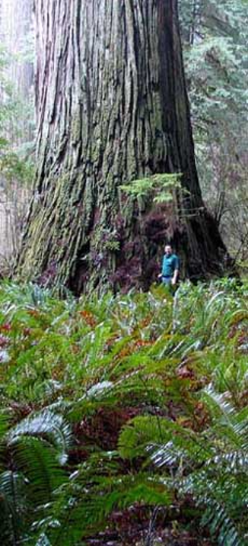
Del Norte Titan
The conifer Del Norte titan is the world’s 5th largest redwood tree. It stands at 93.6 meters (307 ft.) tall.
The trunk measures 7.2 meters around (23.7 ft.).
URL: https://commons.wikimedia.org/wiki/File:Del_Norte_Titan_230.jpg
Attribution: Mario D. Vaden, CC BY 3.0 <https://creativecommons.org/licenses/by/3.0>, via Wikimedia Commons

Slide 4
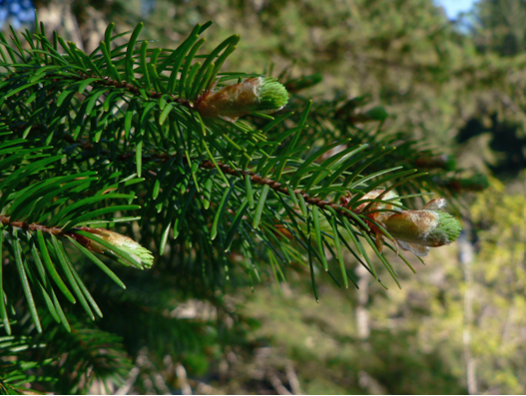
Douglas Fir
The Douglas Fir tree is a conifer with needle-like leaves and buds.
URL: https://commons.wikimedia.org/wiki/File:Pseudotsuga_menziesii_06280.JPG
Attribution: Coast Douglas-fir (Pseudotsuga menziessi subsp. menziesii) Taken by Walter Siegmund https://commons.wikimedia.org/wiki/File:Pseudotsuga_menziesii_06280.JPG This file is licensed under the Creative Commons Attribution-Share Alike 3.0 Unported license.

Slide 5
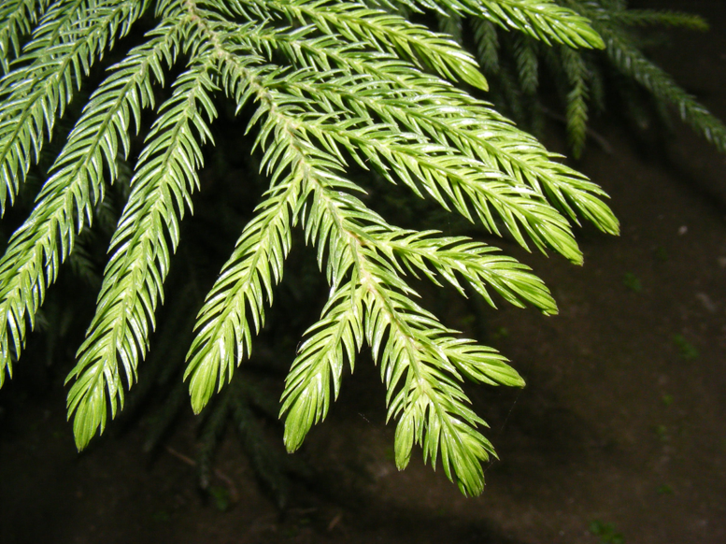
Cook Pine
The awl-shaped leaves of the Cook Pine tree, which is a conifer, are sharp and prickly to the touch.
The leaves are wide at the base and come to a sharp point at the tip, like a tool called an awl, which is used to make holes in leather or wood.
URL: https://commons.wikimedia.org/wiki/File:Araucaria_Leaves.JPG
Attribution: Kumar83, CC BY 3.0 <https://creativecommons.org/licenses/by/3.0>, via Wikimedia Commons

Slide 6
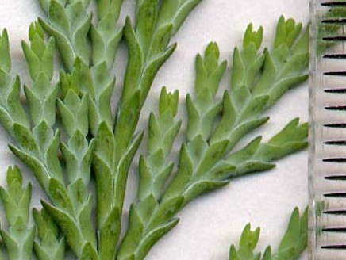
Lawson Cypress
This conifer, a Lawson Cypress tree, has scale-like leaves that overlap like shingles on a roof.
URL: https://commons.wikimedia.org/wiki/File:C_lawsoniana_Lge.jpg
Attribution: MPF at the English-language Wikipedia, CC BY-SA 3.0 <http://creativecommons.org/licenses/by-sa/3.0/>, via Wikimedia Commons

Slide 7
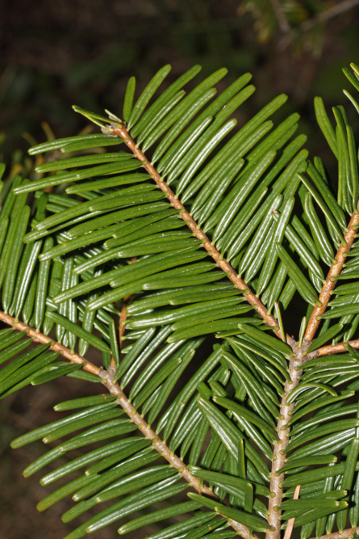
Grand Fir
The Grand Fir (Abies grandes), another conifer, has leaves arranged in a spiral with twisted leaf bases that allow it to capture more light.
URL: https://commons.wikimedia.org/wiki/File:Abies_grandis_5359.JPG
Attribution: Walter Siegmund, CC BY-SA 3.0 <https://creativecommons.org/licenses/by-sa/3.0>, via Wikimedia Commons

Slide 8
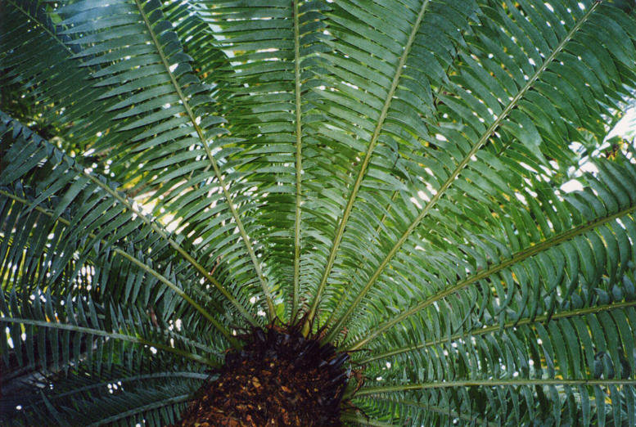
Cycads
Cycads grow leaves coming out from the center trunk in a circular pattern.
Cycads look like palm trees, but they are not related.
URL: https://commons.wikimedia.org/wiki/File:Cycad_leaves_semicircle.jpg
Attribution: Ian Alexander, CC BY-SA 3.0 <https://creativecommons.org/licenses/by-sa/3.0>, via Wikimedia Commons

Slide 9
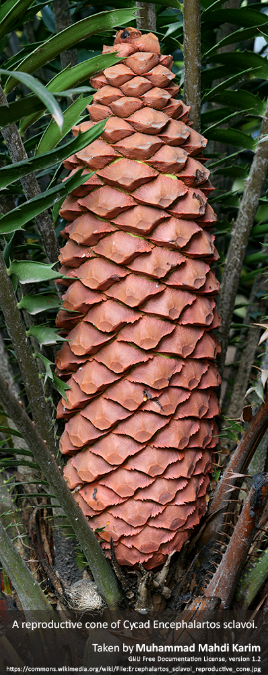
Cycad Cone
This large Cycad cone (seed) is about 30 cm (11.8 in.) long!

Slide 10
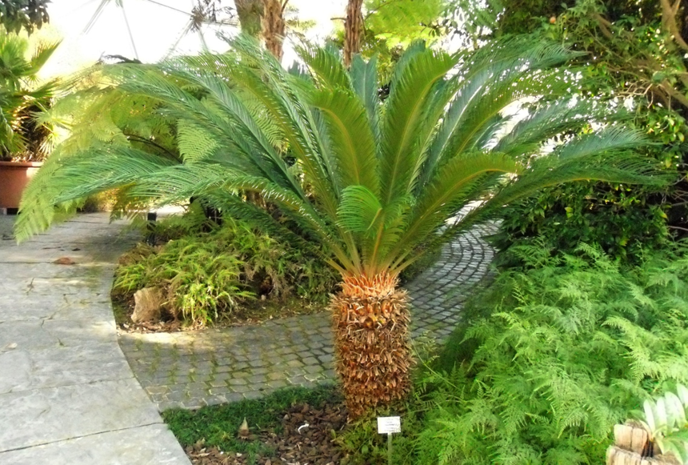
Sago Palm
A Sago palm is not a palm at all; it’s a Cycad.
Be careful around them-- they are poisonous!
URL: https://commons.wikimedia.org/wiki/File:Cycas_revoluta.D%C3%BCsseldorf.jpg
Attribution: Holek, CC BY 3.0 <https://creativecommons.org/licenses/by/3.0>, via Wikimedia Commons

Slide 11
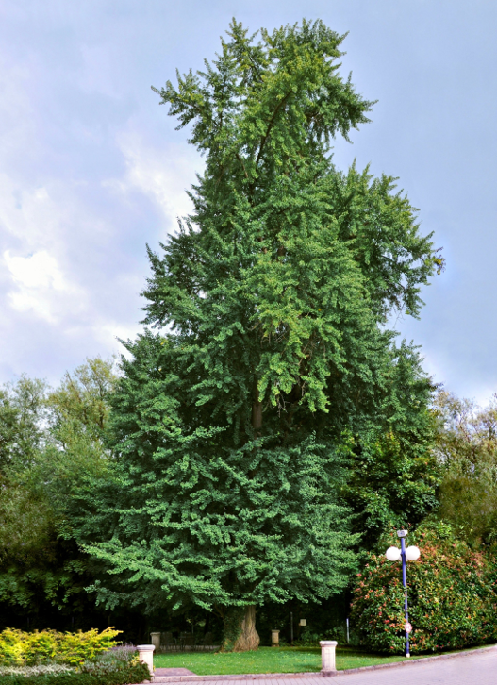
Gingko Trees
Gingko trees can grow very tall, from 20–35 m (66–115 ft), and they can live to be over a thousand years old.
URL: https://commons.wikimedia.org/wiki/File:GINKGOBAUM-2.jpg
Attribution: EecherplazGinkgo06.jpg: Cayambederivative work: Ginkgotree, CC BY-SA 3.0 <https://creativecommons.org/licenses/by-sa/3.0>, via Wikimedia Commons

Slide 12
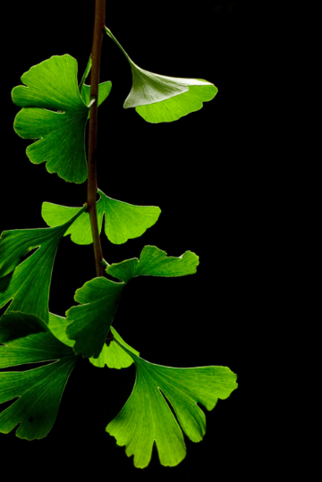
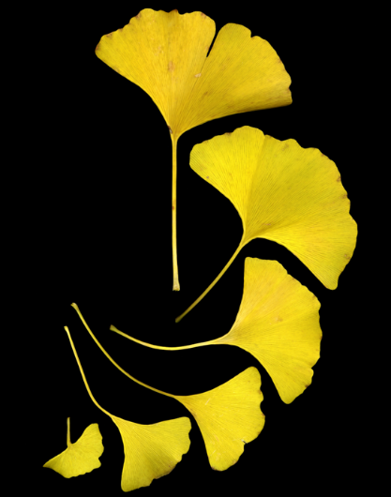
Gingko biloba
Gingko biloba leaves are green in the summer.
In the fall, gingko leaves turn yellow.
URL: https://commons.wikimedia.org/wiki/File:Ginkgo_Biloba_Leaves_-_Black_Background.jpg
Attribution: James Field (Jame), CC BY-SA 3.0 <https://creativecommons.org/licenses/by-sa/3.0>, via Wikimedia Commons
URL: https://commons.wikimedia.org/wiki/File:GinkgoLeaves.jpg
Attribution: Joe Schneid, Louisville, Kentucky, CC BY-SA 3.0 <https://creativecommons.org/licenses/by-sa/3.0>, via Wikimedia Commons

Slide 13
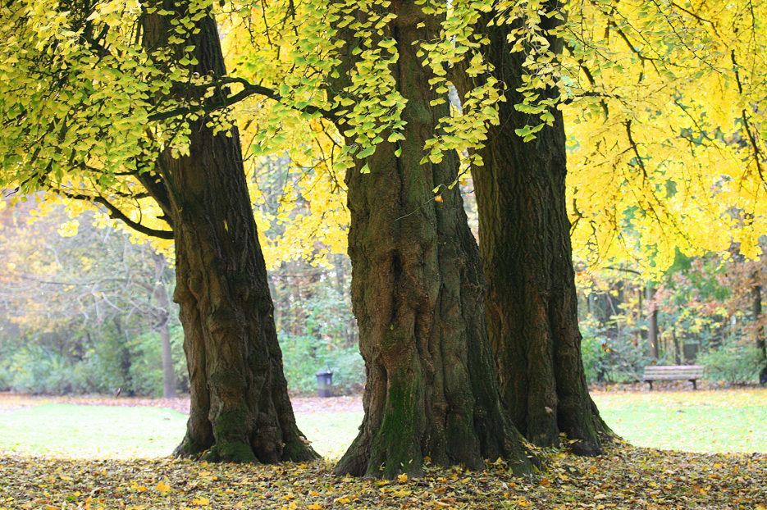
Gingko Trees
Ginko trees are called Maidenhair trees because the blonde color of their leaves in the fall resemble a “maiden’s” long hair.
URL: https://commons.wikimedia.org/wiki/File:Gingko_biloba_JPG2b.jpg
Attribution: Jean-Pol GRANDMONT, CC BY-SA 3.0 <https://creativecommons.org/licenses/by-sa/3.0>, via Wikimedia Commons

Slide 14
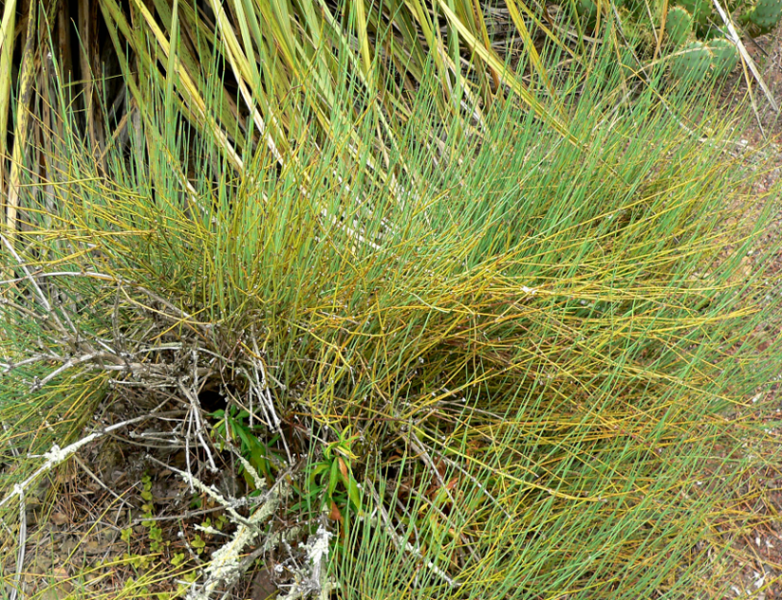
Ephedra californica
Ephedra californica is a gnetophyte that grows in desert habitats.
It is a shrub made up of twigs with tiny leaves on the bumps on the twigs.
URL: https://commons.wikimedia.org/wiki/File:Ephedra_californica_1.jpg
Attribution: Stan Shebs, CC BY-SA 3.0 <https://creativecommons.org/licenses/by-sa/3.0>, via Wikimedia Commons

Slide 15
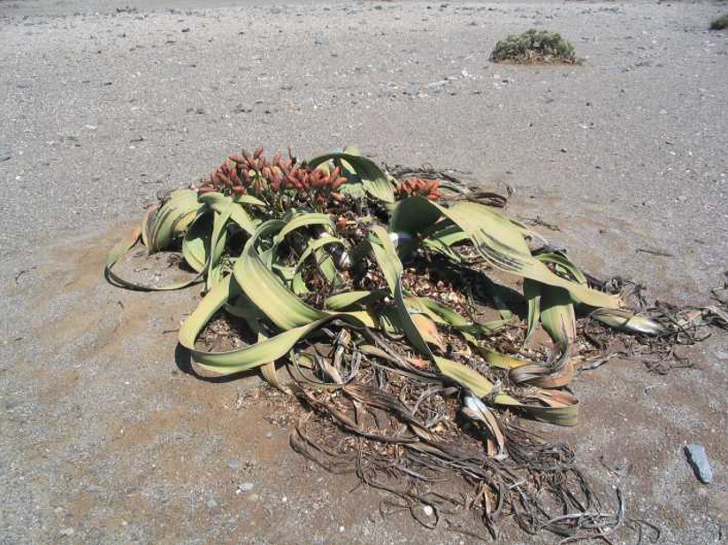
Welwitschia mirabilis
Welwitschia mirabilis is another type of gnetophyte.
It grows only in a dry desert habitat in Africa.
It has long strap-shaped leaves.
URL: https://commons.wikimedia.org/wiki/File:Welwitschia_at_Ugab_River_basin.jpg
Attribution: Muriel Gottrop, CC BY-SA 3.0 <http://creativecommons.org/licenses/by-sa/3.0/>, via Wikimedia Commons

Slide 16
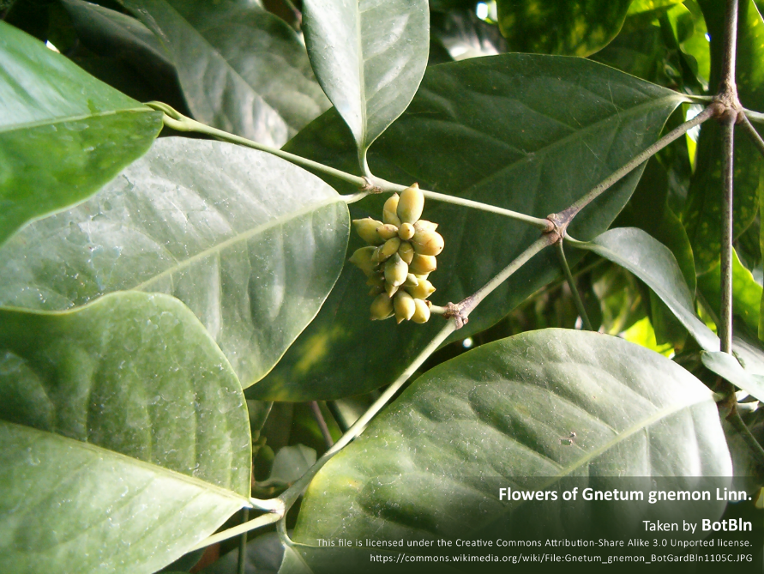
Gnetum gnemon
Gnetum gnemon is also a gnetophyte.
It is a small-to-medium sized tree.
It has evergreen leaves that are wide and opposite each other.

