Slide 1
Day 9 Images

Slide 2
https://commons.wikimedia.org/wiki/File:Tap_and_fibrous_root.jpg
Cassandra gonzales, CC BY-SA 4.0 <https://creativecommons.org/licenses/by-sa/4.0>, via Wikimedia Commons https://commons.wikimedia.org/wiki/File:Tap_Root_%26_Fibrous_Root.png
CRCHF, CC BY-SA 4.0 <https://creativecommons.org/licenses/by-sa/4.0>, via Wikimedia Commons
Angiosperm dicots have taproots, and monocots have a fibrous root system.
Notes:
https://commons.wikimedia.org/wiki/File:Tap_and_fibrous_root.jpg
Cassandra gonzales, CC BY-SA 4.0 <https://creativecommons.org/licenses/by-sa/4.0>, via Wikimedia Commons
https://commons.wikimedia.org/wiki/File:Tap_Root_%26_Fibrous_Root.png
CRCHF, CC BY-SA 4.0 <https://creativecommons.org/licenses/by-sa/4.0>, via Wikimedia Commons

Slide 3
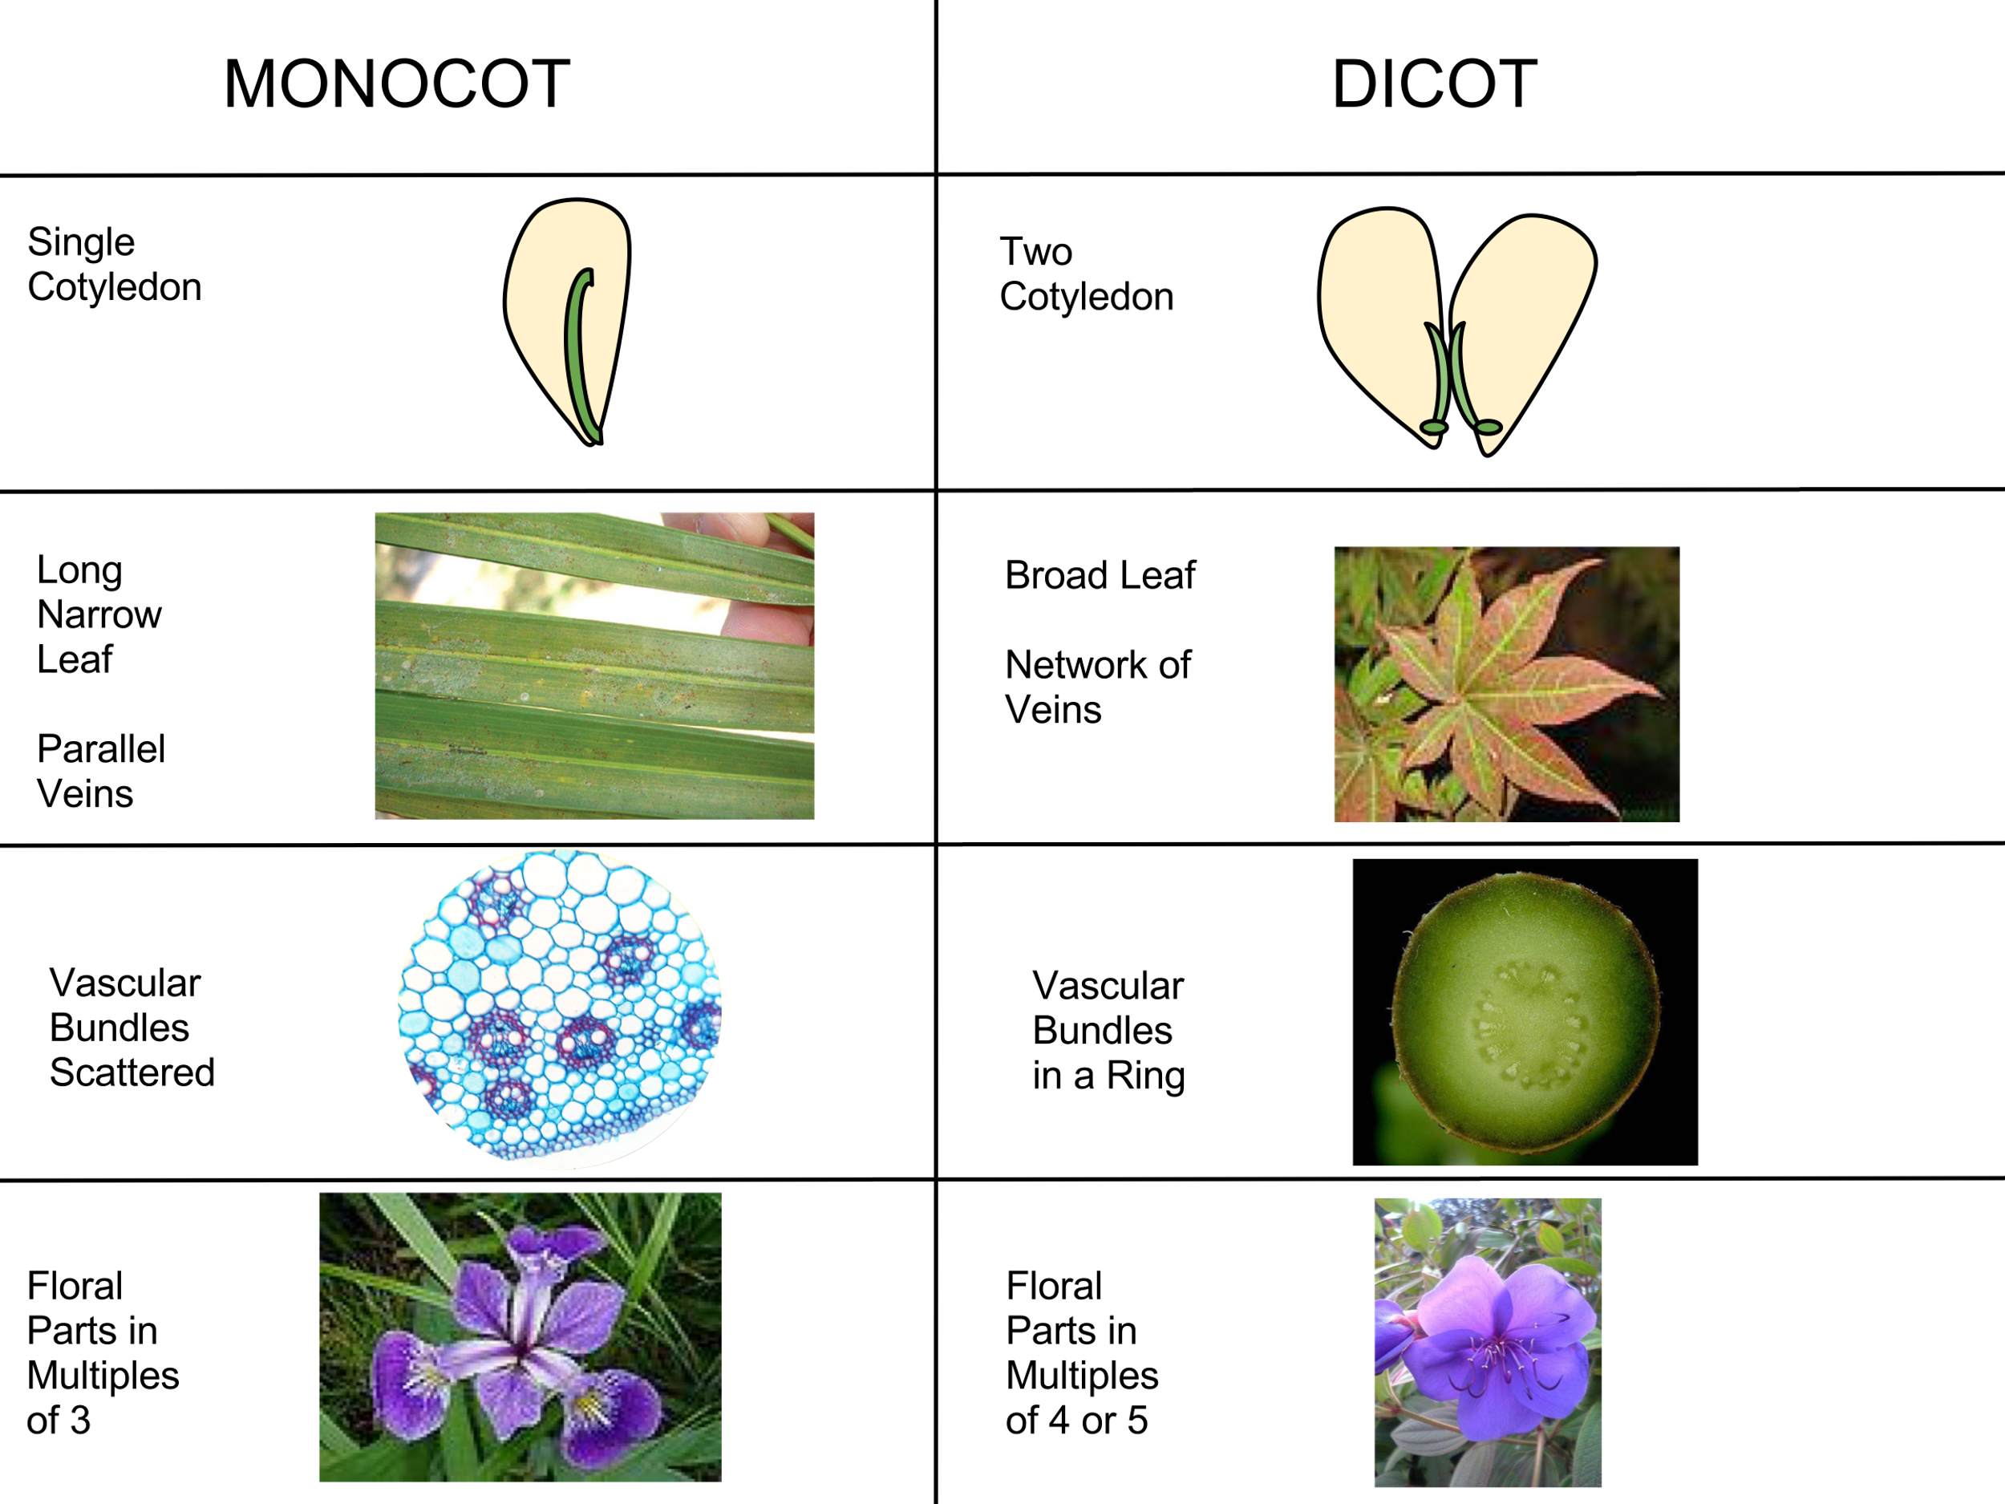
Differences between Angiosperm Monocots and Dicots
https://commons.wikimedia.org/wiki/File:Monocot_vs_Dicot.svg
Flowerpower207, CC BY-SA 3.0 <https://creativecommons.org/licenses/by-sa/3.0>, via Wikimedia Commons

Slide 4
The part of a plant that’s almost ready to flower, or unfurl new leaves is called a bud. This is a rose bud!
URL: https://commons.wikimedia.org/wiki/File:Rose_bud.jpg
Attribution: Amada44, Public domain, via Wikimedia Commons

Slide 5
Krocus vernus (spring crocus) has cupped flower petals.
URL: https://commons.wikimedia.org/wiki/File:Crocus_vernus_20150308.jpg
Attribution:Uoaei1, CC BY-SA 4.0 <https://creativecommons.org/licenses/by-sa/4.0>, via Wikimedia Commons

Slide 6
Agapanthus praecox is a blue lily.
URL: https://commons.wikimedia.org/wiki/File:Agapanthus_cultivar._Zaailing_van_Agapanthus_Lilac_Flash._(d.j.b.)_02.jpg
Attribution: Dominicus Johannes Bergsma, CC BY-SA 4.0 <https://creativecommons.org/licenses/by-sa/4.0>, via Wikimedia Commons

Slide 7
Menyanthes trifoliata is commonly called a bog bean.
URL: https://commons.wikimedia.org/wiki/File:Menyanthes_trifoliata_Spechtensee_01.JPG
Attribution: Uoaei1, CC BY-SA 4.0 <https://creativecommons.org/licenses/by-sa/4.0>, via Wikimedia Commons

Slide 8
Trifolium pratense is known as red clover.
URL: https://commons.wikimedia.org/wiki/File:Trifolium_pratense_-_Keila2.jpg
Attribution: Ivar Leidus, CC BY-SA 4.0 <https://creativecommons.org/licenses/by-sa/4.0>, via Wikimedia Commons

Slide 9
Vaccinium myrtillus is a shrub with an edible blue fruit called bilberry.
URL: https://commons.wikimedia.org/wiki/File:Vaccinium_myrtillus_-_Bilberry_03.jpg
Attribution: Zeynel Cebeci, CC BY-SA 4.0 <https://creativecommons.org/licenses/by-sa/4.0>, via Wikimedia Commons

Slide 10
Noyer feuilles is a type of walnut tree. Its fruit is the walnut.
URL: https://commons.wikimedia.org/wiki/File:Noyer_feuilles%26fruits_%C3%A9t%C3%A9_FR_2012.jpg
Attribution: JLPC, CC BY-SA 3.0 <https://creativecommons.org/licenses/by-sa/3.0>, via Wikimedia Commons

Slide 11
A flower of the Lupinus polyphyllus, a large-leaved pea plant.
URL: https://commons.wikimedia.org/wiki/File:Lupinus_polyphyllus_FR_2012.jpg
Attribution: JLPC, CC BY-SA 3.0 <https://creativecommons.org/licenses/by-sa/3.0>, via Wikimedia Commons

Slide 12
Parodia tenuicylindrica (Notocactus minimus) is a cactus with yellow flowers.
URL: https://commons.wikimedia.org/wiki/File:Notocactus_minimus.jpg
Attribution: Laitche, Public domain, via Wikimedia Commons

Slide 13
Hebe speciosa is an ornamental plant from New Zealand.
URL: https://commons.wikimedia.org/wiki/File:Hebe_January_2008-2.jpg
Attribution: Alvesgaspar, CC BY-SA 3.0 <https://creativecommons.org/licenses/by-sa/3.0>, via Wikimedia Commons

Slide 14
Hibiscus boryanus—fruit, flower, and bud.
URL: https://commons.wikimedia.org/wiki/File:Hibiscus_boryanus_fruit_flower_%26_bud.JPG
Attribution: B.navez, CC BY-SA 3.0 <https://creativecommons.org/licenses/by-sa/3.0>, via Wikimedia Commons

Slide 15
A flower of the Clove-like cactus Echinopsis oxygona
URL: https://commons.wikimedia.org/wiki/File:Echinopsis_IMG_2981.jpg
Attribution: Fischer.H, CC BY-SA 4.0 <https://creativecommons.org/licenses/by-sa/4.0>, via Wikimedia Commons

Slide 16
Dianthus zonatus–Rock Carnation
URL: https://commons.wikimedia.org/wiki/File:Dianthus_zonatus_-_Rock-carnation_-_Kaya_karanfili_2.JPG
Attribution: Zeynel Cebeci, CC BY-SA 4.0 <https://creativecommons.org/licenses/by-sa/4.0>, via Wikimedia Commons

Slide 17
Rosa moschata, the musk rose
URL: https://commons.wikimedia.org/wiki/File:Rosa_%27moonlight%27_Moschatahybride_002.JPG
Attribution: Dominicus Johannes Bergsma, CC BY-SA 4.0 <https://creativecommons.org/licenses/by-sa/4.0>, via Wikimedia Commons

