Slide 1
How to Make Mold and Cast Fossils

Slide 2
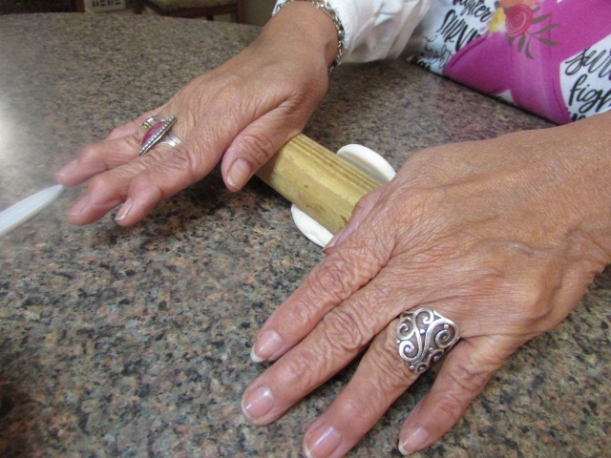
Open package of air-dry clay and roll it into a smooth ball. Use a rolling pin or substitute to roll out flat (about 1/4” thick)

Slide 3
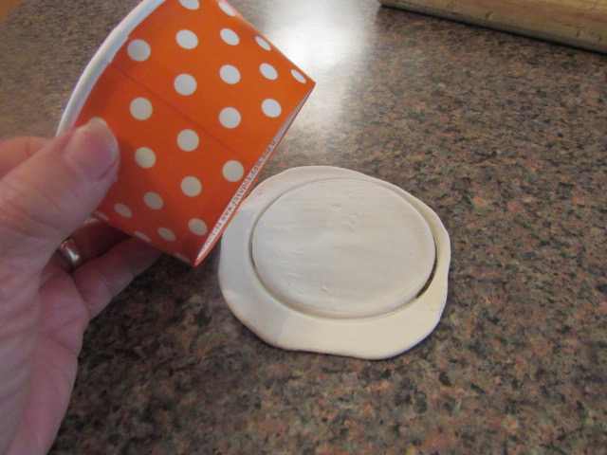
Use the bottom of the ice cream cup to press a circle (like a cookie cutter) into the clay. Gently remove the circle from the cup.

Slide 4
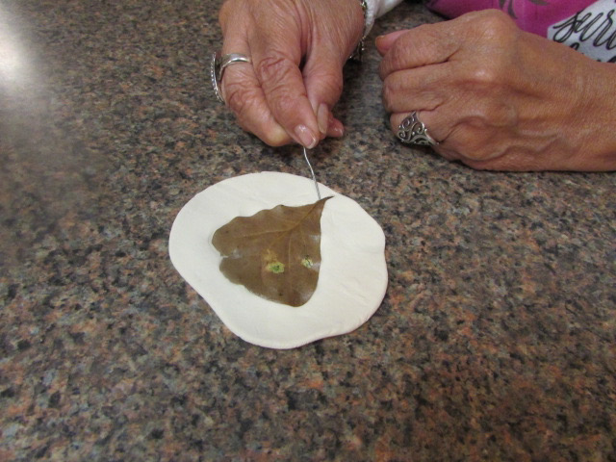
Place the plant leaf on the clay then press it GENTLY onto the circle with your hands. Lift off the leaf carefully so that the imprint is not disturbed. You may use an open paper clip to lift it out if needed.

Slide 5
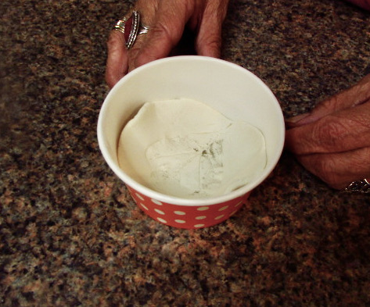
See the imprint—it’s a mold of the plant parts! Gently place the circle with the imprint face up inside of the cup.

Slide 6
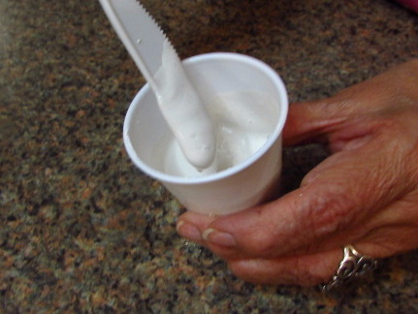
Add water a little at a time to the cup containing the plaster of paris (you may use a dropper, if available). Stir. The mixture should be “creamy” but not runny.

Slide 7
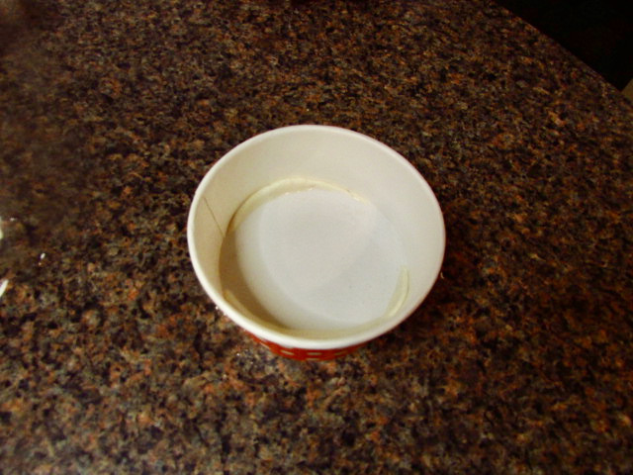
When ready, pour slowly over the mold. Do not shake the cup. The plaster will need to dry overnight (or at least 24 hours) to harden.

Slide 8
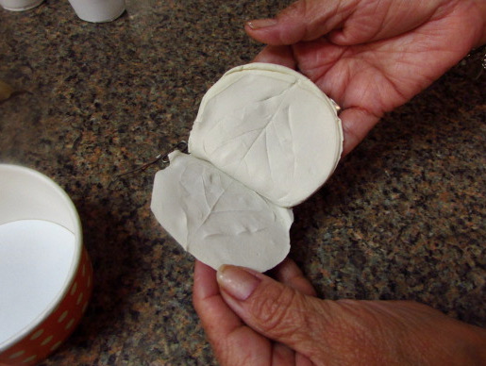
Next day (when dry), carefully remove the entire fossil from the cup and lift the clay off to reveal the cast!

