Slide 1
Plant Habitats and Adaptations
Grade 3 Plants Unit

Slide 2
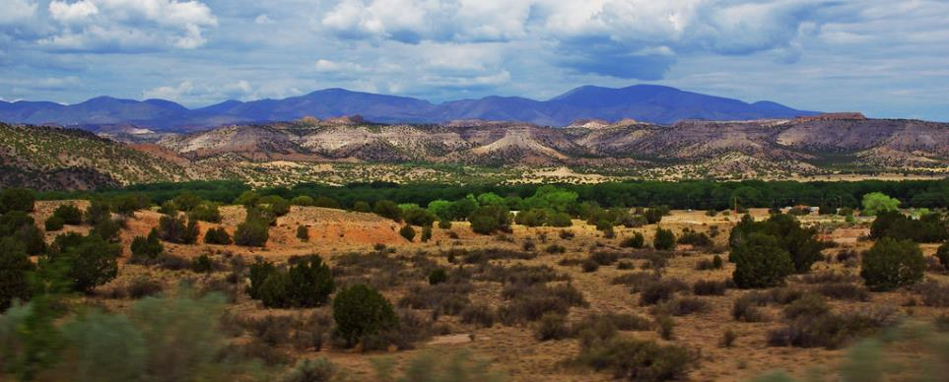
Desert Habitat
URL: https://www.flickr.com/photos/49580580@N02/5989098056
Attribution: "Desert Landscape - New Mexico" by Thomas Shahan 3 is licensed under CC BY 2.0
Very dry—less than 10 inches of annual rainfall.
Often hot during day, cold at night.
Direct sunlight (low shade).
Sandy and rocky soil—not able to hold much water.
Strong winds.
Plants must prevent extensive water loss.

Slide 3
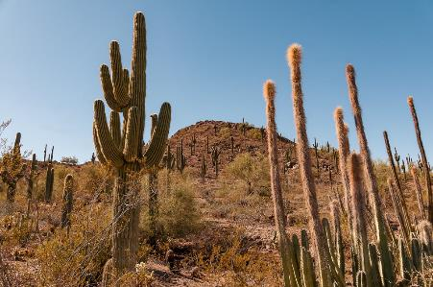
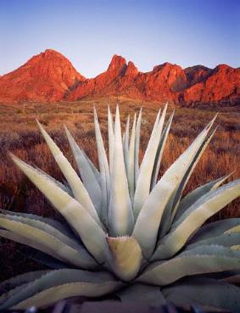
Plant Adaptations
Succulents—plants with thick, fleshy tissues—store water in stems or leaves.
URL: https://www.flickr.com/photos/13445173@N06/48377615021
Attribution: "Cactus in Desert Landscape - Desert Botanical Gardens, Phoenix" by bvi4092 is licensed under CC BY 2.0
Waxy or smooth leaves and stems help reduce water loss.
Long root systems spread out to absorb water.
URL: https://www.flickr.com/photos/10573648@N05/924781390
Attribution: "desert_plant" by Zest-pk is licensed under CC BY 2.0

Slide 4
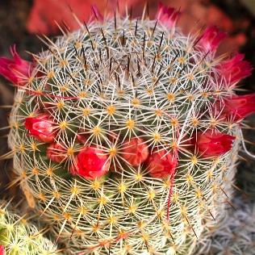
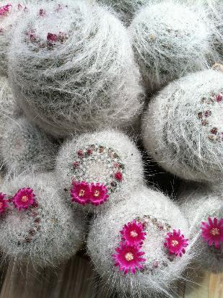
Barrel cactus have spines instead of leaves and store water in thick stems.
URL: "Barrel cactus flower" by kevin dooley is licensed under CC BY 2.0
Attribution: https://www.flickr.com/photos/12836528@N00/5532742662
Spines discourage animals from eating plants for their store water.
Some cactus have fine white hairs to shade them from the Sun.
URL: https://www.flickr.com/photos/31867959@N04/7134211087
Attribution: "Mammillaria hahniana" by Dallas Krentzel is licensed under CC BY 2.0

Slide 5
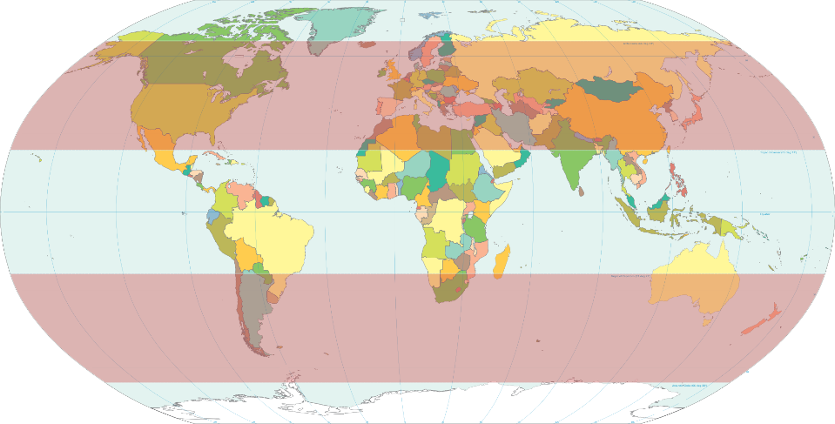
Temperate Zones on the World Map
URL https://commons.wikimedia.org/wiki/File:World_map_temperate.svg
Attribution: HorsePunchKid, Public domain, via Wikimedia Commons

Slide 6
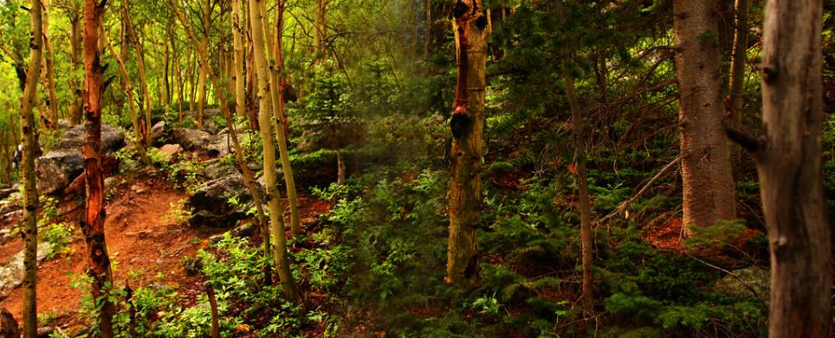
URL: https://www.flickr.com/photos/10393601@N08/4843082944
Attribution: "deciduous forest" by Rennett Stowe is licensed under CC BY 2.0
Temperate Deciduous- Forest
Habitat
Four distinct seasons—hot to freezing.
Plentiful rainfall—30 to 60 inches per year.
Layers of plants—canopy (upper layer), understory (underlying layer of vegetation, or plant life, made up of seedlings, shrubs, and herbs).
Soil rich with decomposing vegetative matter.

Slide 7
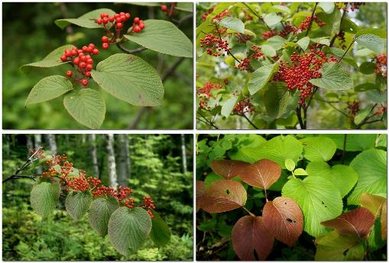
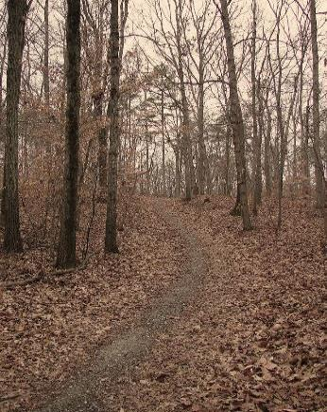
Plant Adaptations
Trees have thin, broad leaves to capture sunlight, but drop them in the fall to minimize water loss.
URL: https://www.flickr.com/photos/62938898@N00/8654220741
Attribution: "Viburnum furcatum in the forest, Sakhalin" by Tatters ✾ is licensed under CC BY-SA 2.0
Many plants have broad leaves to compete with other plants for sunlight.
URL: https://www.flickr.com/photos/62938898@N00/8654220741
Attribution: "Viburnum furcatum in the forest, Sakhalin" by Tatters ✾ is licensed under CC BY-SA 2.0
URL: https://www.flickr.com/photos/98528214@N00/360305885
Attribution: "Through Trees" by Furryscaly is licensed under CC BY-SA 2.0

Slide 8
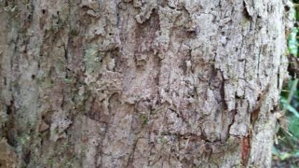
• Trees have thick bark to protect against freezing, fire, and insects.
URL: https://www.flickr.com/photos/128402268@N08/15272405140
Attribution: "BS_DG_2_081_B-Xylosma_sp" by trec admin is licensed under CC BY-NC 2.0
By winter, the deciduous trees have shed all their leaves and wait for spring.
https://commons.wikimedia.org/wiki/File:Bare_trees.jpg
Shadow Ayush, CC BY-SA 4.0 <https://creativecommons.org/licenses/by-sa/4.0>, via Wikimedia Commons

Slide 9
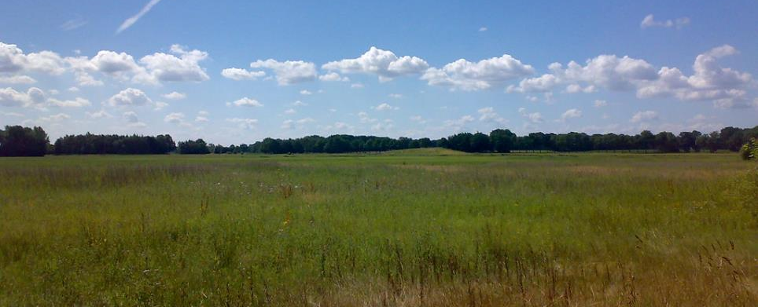
Temperate Grasslands Habitat
URL: https://www.flickr.com/photos/60057960@N06/5483275739
Attribution: "Grassland" by Ruben Holthuijsen is licensed under CC BY 2.0
Flat, open areas made up of tall grasses.
Found between areas of forest and desert, often on their borders.
Low rainfall—20 to 35 inches per year.
Climate is dry most of the year (hot summers and cold winters).
Prairies (North American grasslands) have nutrient-rich soil good for farming.

Slide 10
Plant Adaptations
Leaves on grasses are long and narrow so they lose less water during evaporation.
Grasses have a fibrous, deep-spreading root system to reach underground water during dry conditions.
Roots also protect the grasses from being destroyed by fire or animal grazing.
URL https://commons.wikimedia.org/wiki/File:Grass_dsc08672-nevit.jpg
Attribution: Nevit Dilmen, CC BY-SA 3.0 <http://creativecommons.org/licenses/by-sa/3.0/>, via Wikimedia Commons
URL https://commons.wikimedia.org/wiki/File:Switchgrass_roots.jpg
Attribution: Dehaan, CC BY 3.0 <https://creativecommons.org/licenses/by/3.0>, via Wikimedia Commons

Slide 11
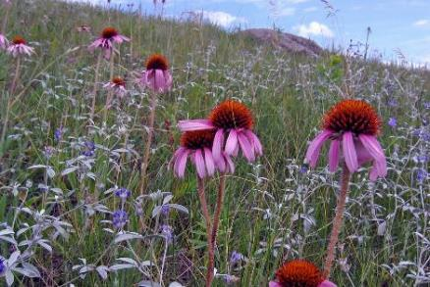
Purple Coneflower
Flowering plants found in North American prairies include the following:
Milk Weed
URL: https://www.flickr.com/photos/51986662@N05/14725921304
Attribution: "Purple Coneflower" by USFWS Mountain Prairie is licensed under CC BY 2.0
Goldenrod (Solidago multiradiata)
URL: https://commons.wikimedia.org/wiki/File:Mead%27s_Milkweed_(Asclepias_meadii)_-_Flickr_-_Jay_Sturner_(2).jpg
Attibution: Jay Sturner from USA, CC BY 2.0 <https://creativecommons.org/licenses/by/2.0>, via Wikimedia Commons
URL https://commons.wikimedia.org/wiki/File:Solidago_multiradiata_(6120997092).jpg
Attribution: Matt Lavin from Bozeman, Montana, USA, CC BY-SA 2.0 <https://creativecommons.org/licenses/by-sa/2.0>, via Wikimedia Commons

